Slide 1
The VCG Auction
(Vickrey-Clarke-Groves)
INFO 4220 – Networks II: Market Design
Based on Haeringer Ch. 4

Slide 2
The VCG Auction
There are many auctions where multiple objects are sold at the same time: Timber, spectrum, etc
Often buyers only want a combination of this objects (a subset of the items). But:
  Bidders may want to participate in more auctions than the number of items they want
  Bidders do not want to buy more items than they need
The VCG auction is the solution to this problem

Slide 3
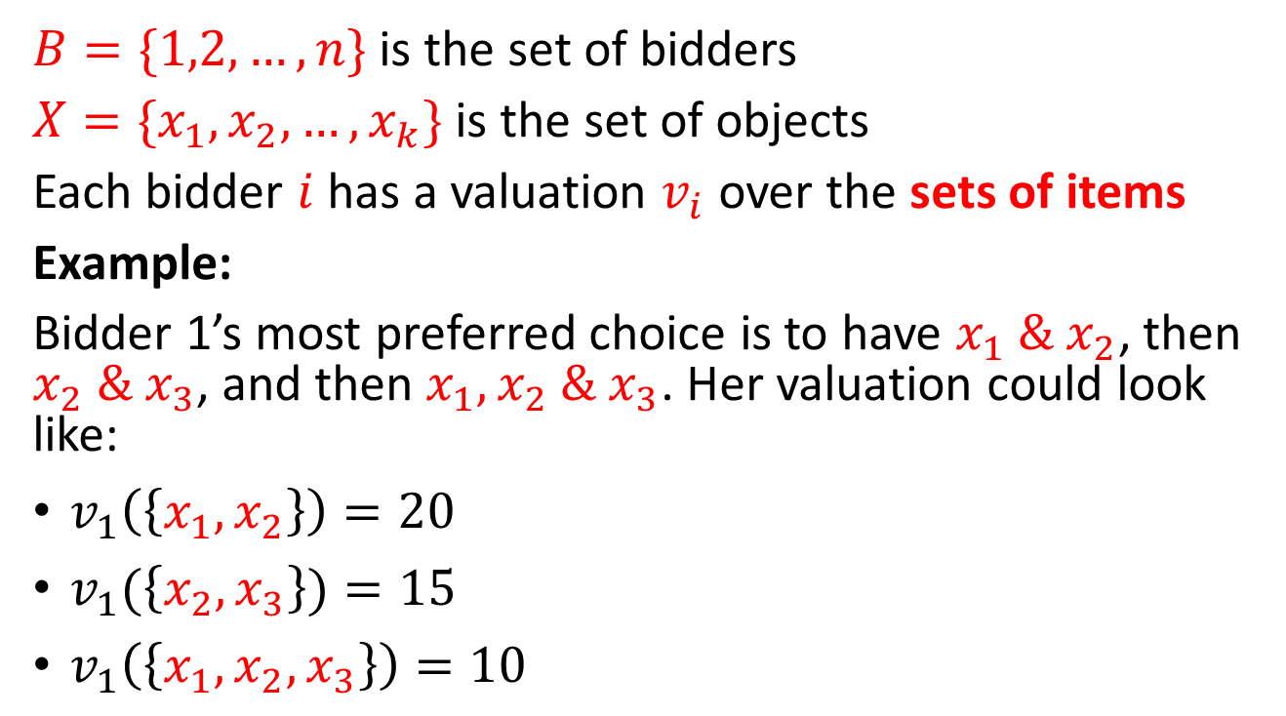
Model
$B=\{1,2,…,n\}$ is the set of bidders
$X=\{x_{1},x_{2},…,x_{k}\}$ is the set of objects
Each bidder $i$ has a valuation $v_{i}$ over the sets of items
Example:
Bidder 1’s most preferred choice is to have $x_{1} \& x_{2}$, then $x_{2} \& x_{3}$, and then $x_{1}, x_{2} \& x_{3}$. Her valuation could look like:
$v_{1}\left(\left\{x_{1},x_{2}\right\}\right)=20$
$v_{1}(\left\{x_{2},x_{3}\right\})=15$
$v_{1}\left(\left\{x_{1},x_{2},x_{3}\right\}\right)=10$

Slide 4
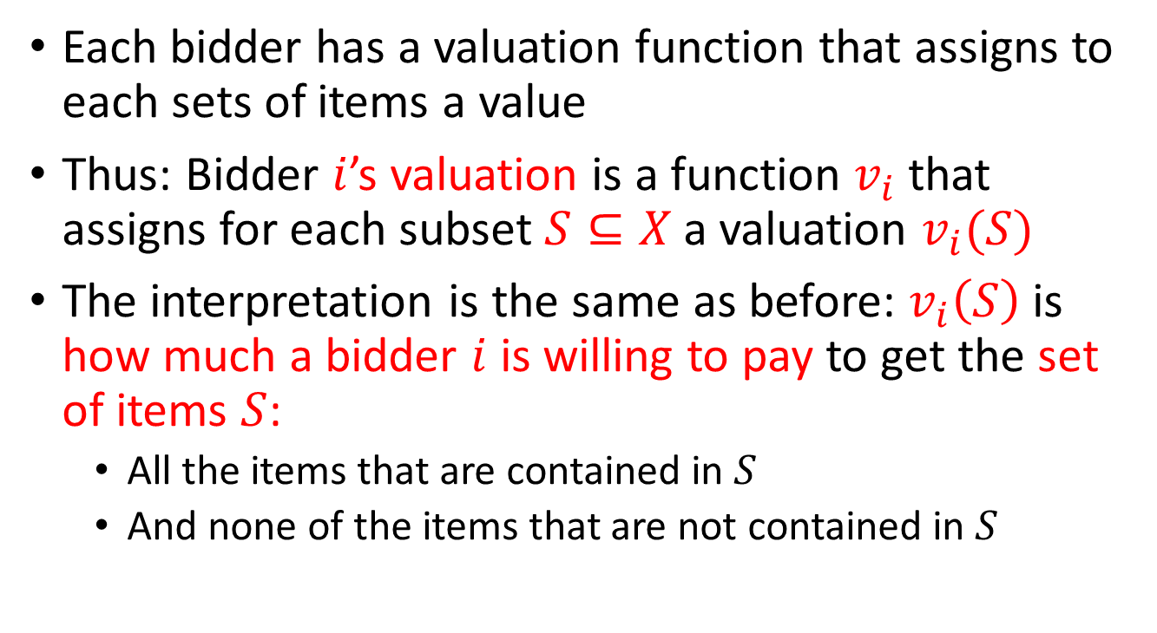
Valuation Function
Each bidder has a valuation function that assigns to each sets of items a value
Thus: Bidder $i$’s valuation is a function $v_{i}$ that assigns for each subset $S⊆X$ a valuation $v_{i}(S)$
The interpretation is the same as before: $v_{i}\left(S\right)$ is how much a bidder $i$ is willing to pay to get the set of items $S$:
  All the items that are contained in $S$
  And none of the items that are not contained in $S$

Slide 5
The VCG Auction
Each bidder submits her bid function
  Like in a sealed-bid auction
The assignment (who gets what) is the one that maximizes the social value
Each bidder pays the externality she imposes on the other bidders

Slide 6
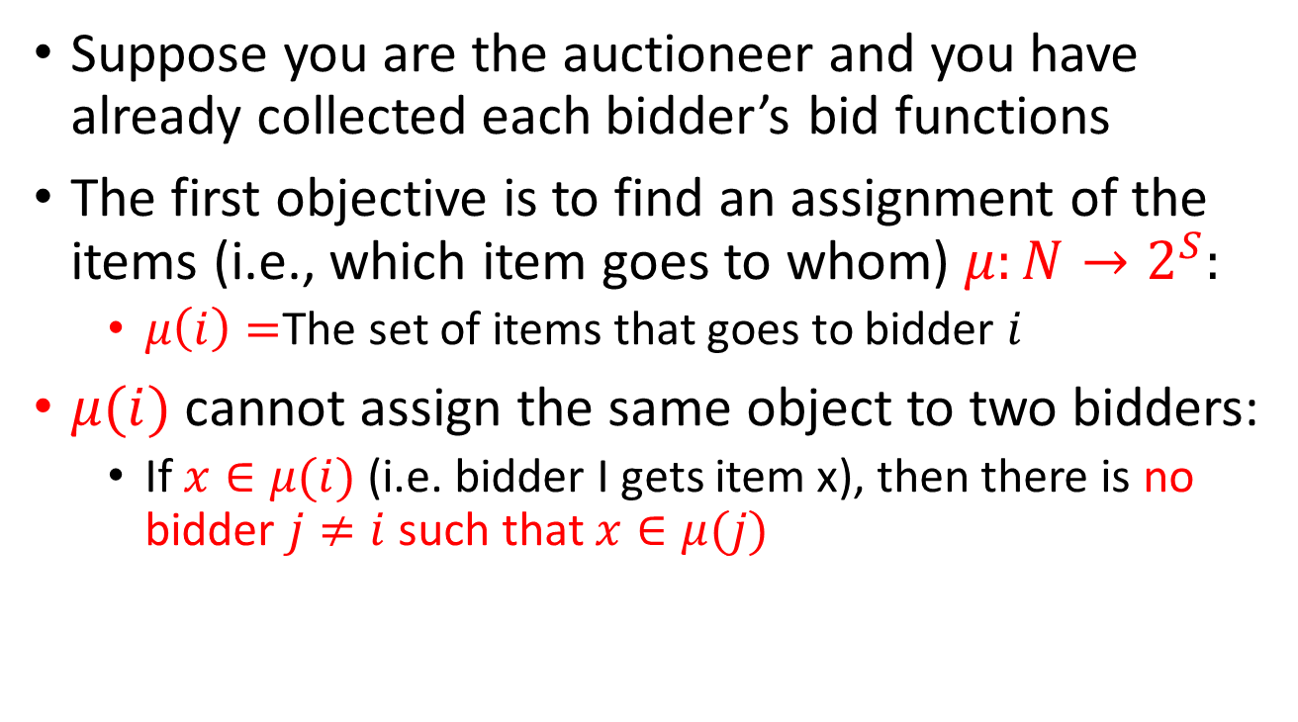
Maximizing Social Value
Suppose you are the auctioneer and you have already collected each bidder’s bid functions
The first objective is to find an assignment of the items (i.e., which item goes to whom) $μ:N→2^{S}:$
  $μ\left(i\right)=$The set of items that goes to bidder $i$
$μ(i)$ cannot assign the same object to two bidders:
  If $x∈μ(i)$ (i.e. bidder I gets item x), then there is no bidder $j≠i$ such that $x∈μ(j)$

Slide 7
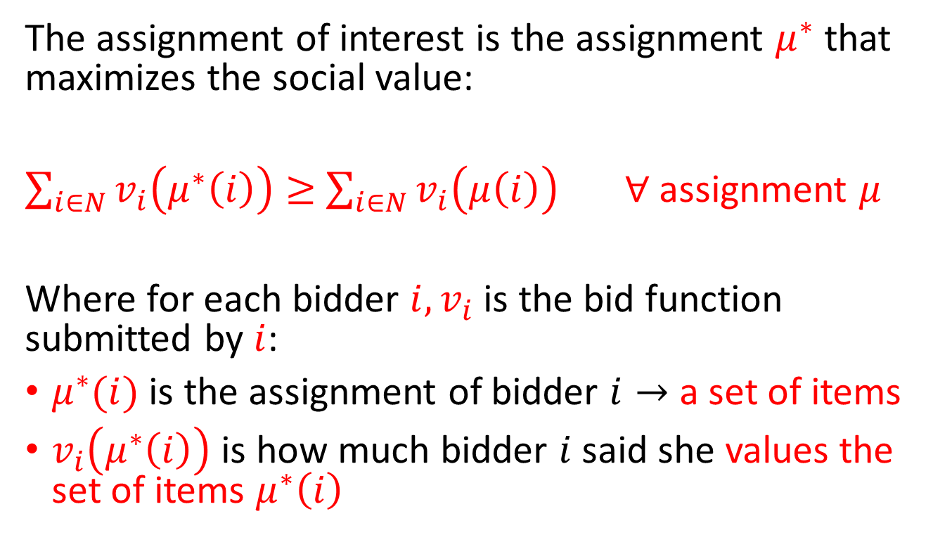
Maximizing Social Value
The assignment of interest is the assignment $μ^{∗}$ that maximizes the social value:
$\sum_{i∈N}{v_{i}\left(μ^{∗}\left(i\right)\right)≥}$ $\sum_{i∈N}{v_{i}\left(μ\left(i\right)\right)}$ $∀$assignment $μ$
Where for each bidder $i, v_{i}$is the bid function submitted by $i$:
$μ^{∗}(i)$ is the assignment of bidder $i→$ a set of items
$v_{i}\left(μ^{∗}\left(i\right)\right)$ is how much bidder $i$said she values the set of items $μ^{∗}\left(i\right)$

Slide 8
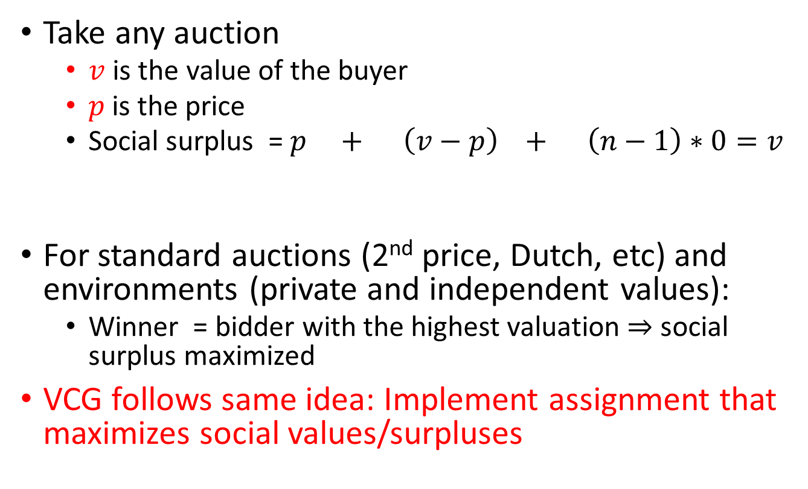
Why maximizing the social value?
Take any auction
  $v$ is the value of the buyer
  $p$is the price
  Social surplus = $p + \left(v−p\right) + \left(n−1\right)∗0=v$
For standard auctions (2nd price, Dutch, etc) and environments (private and independent values):
  Winner = bidder with the highest valuation $⇒$ social surplus maximized
VCG follows same idea: Implement assignment that maximizes social values/surpluses
Seller’s surplus
Winner’s surplus
Loser’s surplus

Slide 9
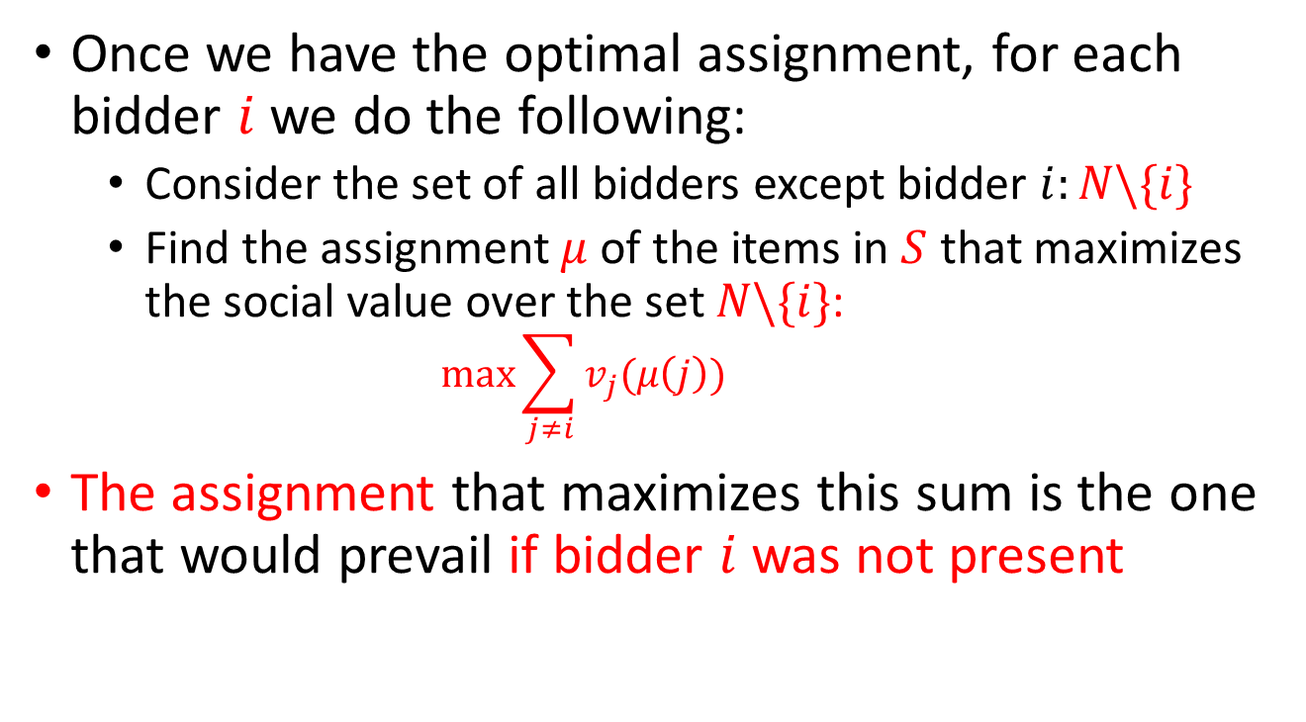
Paying the Externality
Once we have the optimal assignment, for each bidder $i$ we do the following:
  Consider the set of all bidders except bidder $i:N\backslash \{i\}$
  Find the assignment $μ$ of the items in $S$ that maximizes the social value over the set $N\backslash \{i\}$:
    $$\max{\sum_{j≠i}{v_{j}(μ\left(j\right))}}$$
The assignment that maximizes this sum is the one that would prevail if bidder $i$ was not present

Slide 10
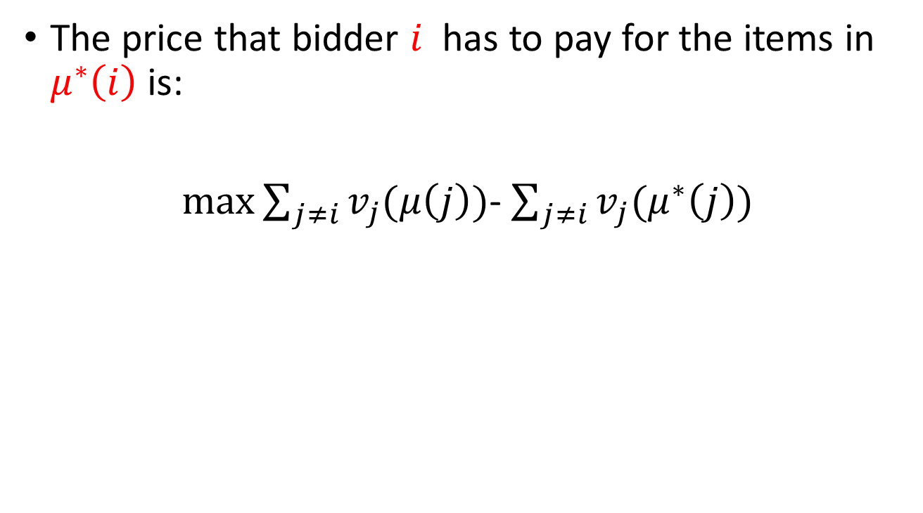
Paying the Externality
The price that bidder $i$ has to pay for the items in $μ^{∗}\left(i\right)$is:
$\max{\sum_{j≠i}{v_{j}(μ\left(j\right))}}$- $\sum_{j≠i}{v_{j}(μ^{∗}\left(j\right))}$
Other’s social value without bidder i
Other’s social value with bidder i

Slide 11
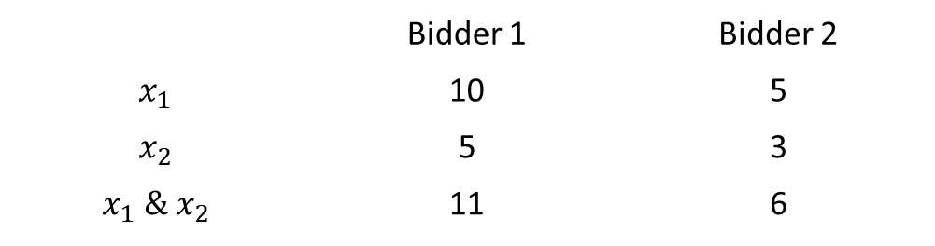
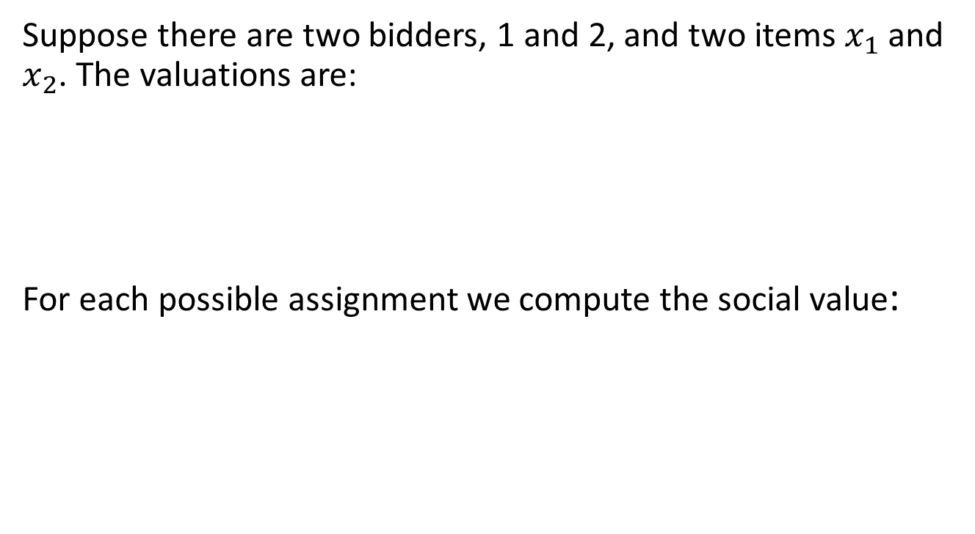
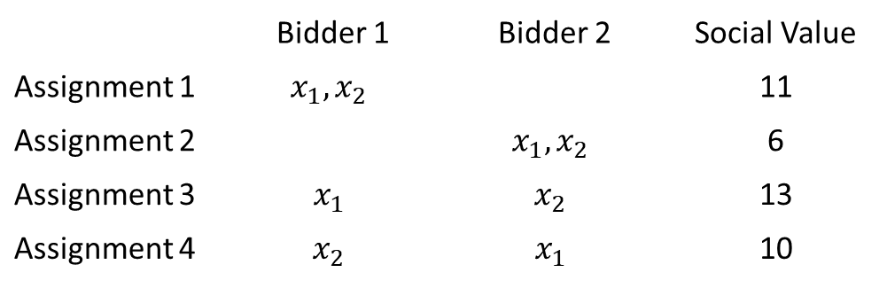
Example
Suppose there are two bidders, 1 and 2, and two items $x_{1}$ and $x_{2}$. The valuations are:
For each possible assignment we compute the social value:
 | Bidder 1 | Bidder 2
$$x_{1}$$ | 10 | 5
$$x_{2}$$ | 5 | 3
$$x_{1} \& x_{2}$$ | 11 | 6
 | Bidder 1 | Bidder 2 | Social Value
Assignment 1 | $$x_{1}, x_{2}$$ |  | 11
Assignment 2 |  | $$x_{1}, x_{2}$$ | 6
Assignment 3 | $$x_{1}$$ | $$x_{2}$$ | 13
Assignment 4 | $$x_{2}$$ | $$x_{1}$$ | 10

Slide 12
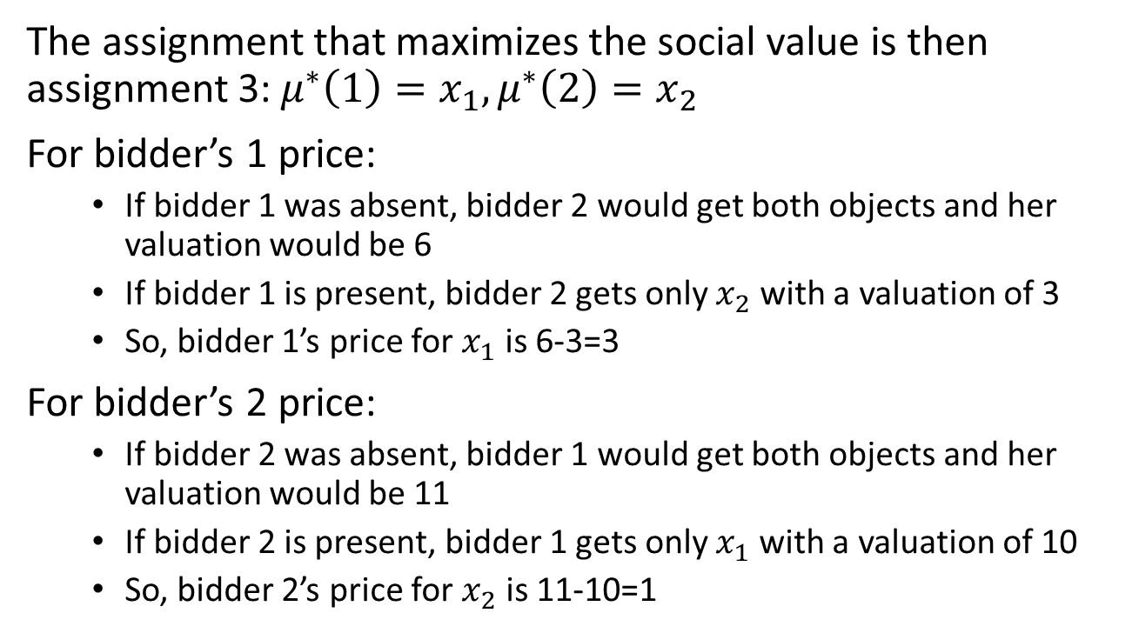
Example
The assignment that maximizes the social value is then assignment 3: $μ^{∗}\left(1\right)=x_{1}, μ^{∗}\left(2\right)=x_{2}$
For bidder’s 1 price:
  If bidder 1 was absent, bidder 2 would get both objects and her valuation would be 6
  If bidder 1 is present, bidder 2 gets only $x_{2}$ with a valuation of 3
  So, bidder 1’s price for $x_{1}$ is 6-3=3
For bidder’s 2 price:
  If bidder 2 was absent, bidder 1 would get both objects and her valuation would be 11
  If bidder 2 is present, bidder 1 gets only $x_{1}$ with a valuation of 10
  So, bidder 2’s price for $x_{2}$ is 11-10=1

Slide 13
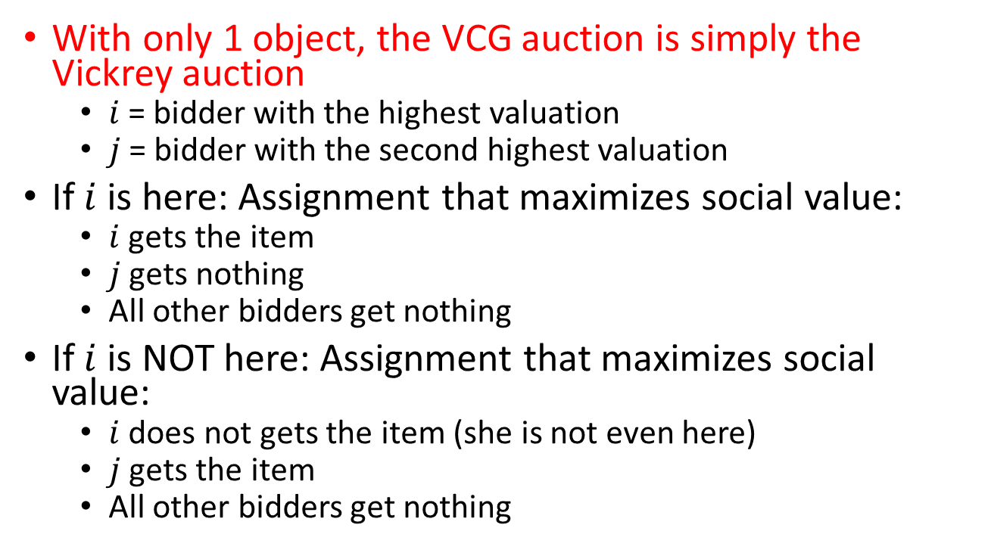
VCG with 1 object
With only 1 object, the VCG auction is simply the Vickrey auction
  $i$= bidder with the highest valuation
  $j$= bidder with the second highest valuation
If $i$ is here: Assignment that maximizes social value:
  $i$ gets the item
  $j$ gets nothing
  All other bidders get nothing
If $i$ is NOT here: Assignment that maximizes social value:
  $i$ does not gets the item (she is not even here)
  $j$ gets the item
  All other bidders get nothing

Slide 14
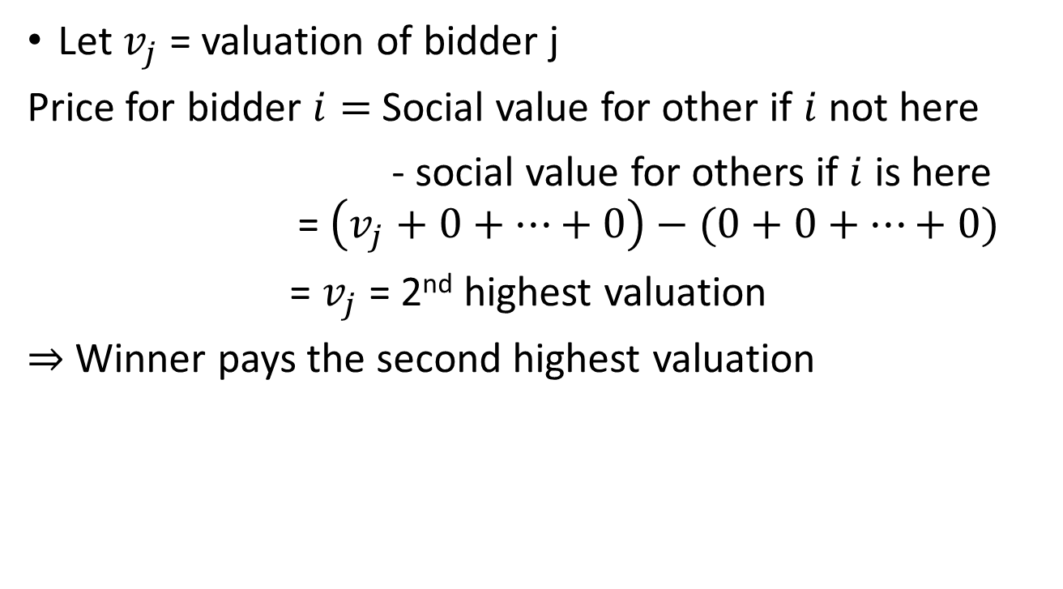
VCG with 1 object
Let $v_{j}$ = valuation of bidder j
Price for bidder $i=$ Social value for other if $i$ not here
- social value for others if $i$ is here = $\left(v_{j}+0+…+0\right)−(0+0+…+0)$
= $v_{j}$ = 2nd highest valuation
$⇒$ Winner pays the second highest valuation

Slide 15
Truthful bidding under VCG
Auctioneer does not know the bidder’s valuations. She can only see the bids: Everything is calculated using bids
Bidders may not be forced to submit their true valuation functions. They can be whatever they like
However, submitting one’s true valuation function is a dominant strategy in the VCG auction

Slide 16
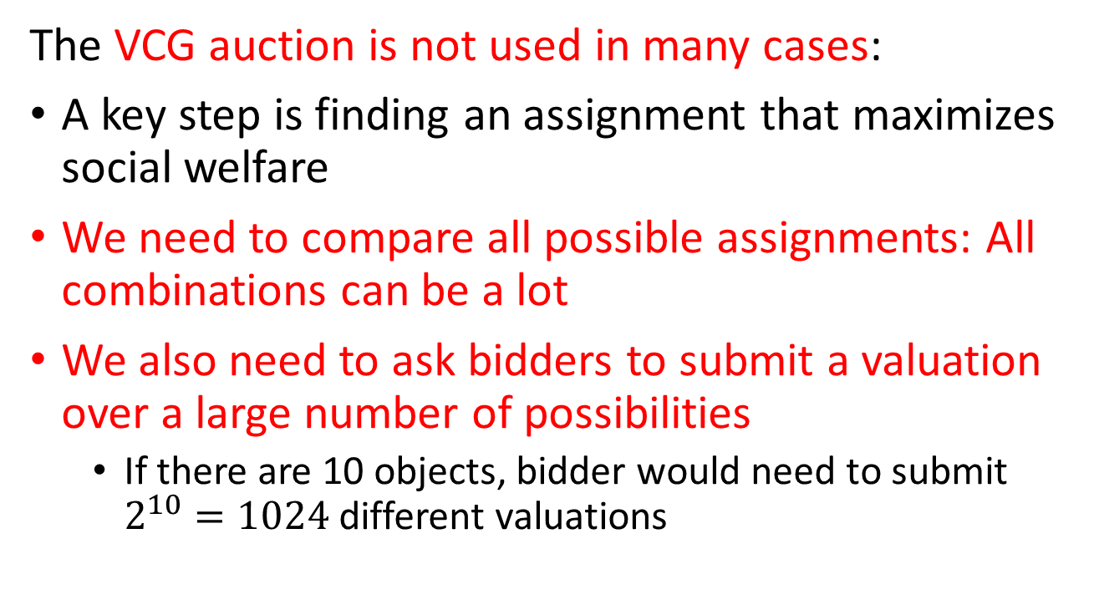
Problems with VCG Auction
The VCG auction is not used in many cases:
A key step is finding an assignment that maximizes social welfare
We need to compare all possible assignments: All combinations can be a lot
We also need to ask bidders to submit a valuation over a large number of possibilities
  If there are 10 objects, bidder would need to submit $2^{10}=1024$ different valuations

Slide 17
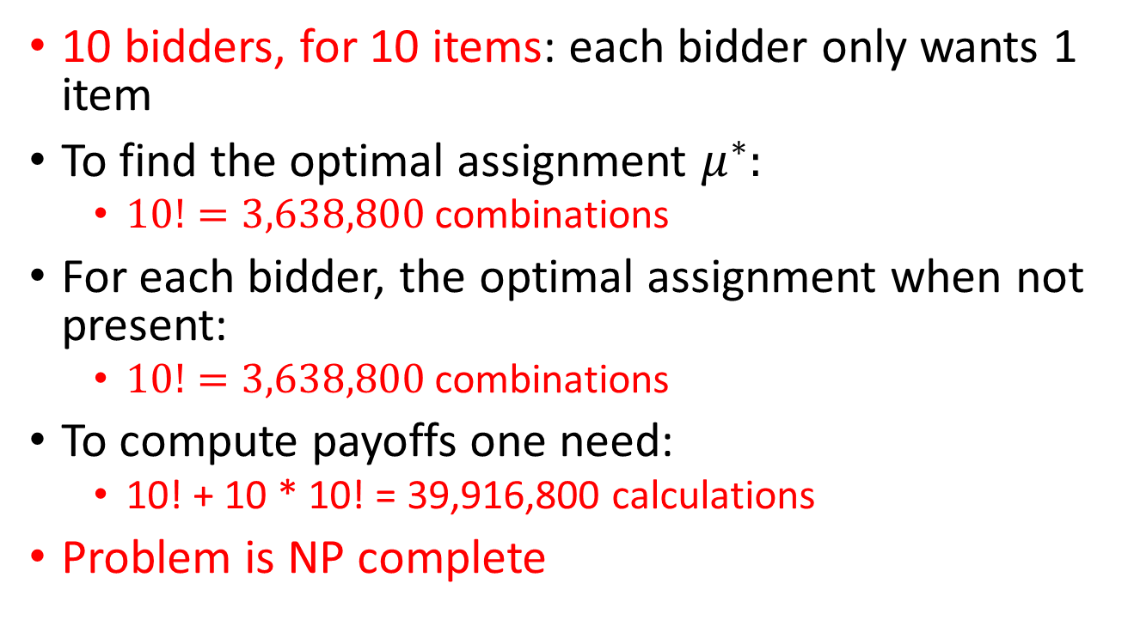
Example
10 bidders, for 10 items: each bidder only wants 1 item
To find the optimal assignment $μ^{∗}:$
  $10!=3,638,800$ combinations
For each bidder, the optimal assignment when not present:
  $10!=3,638,800$ combinations
To compute payoffs one need:
  10! + 10 * 10! = 39,916,800 calculations
Problem is NP complete

